Slide 1


Slide 2
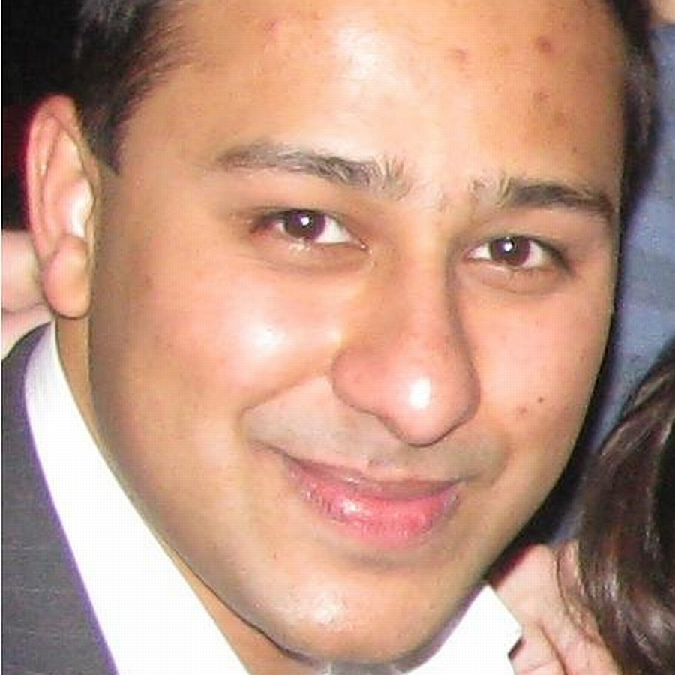

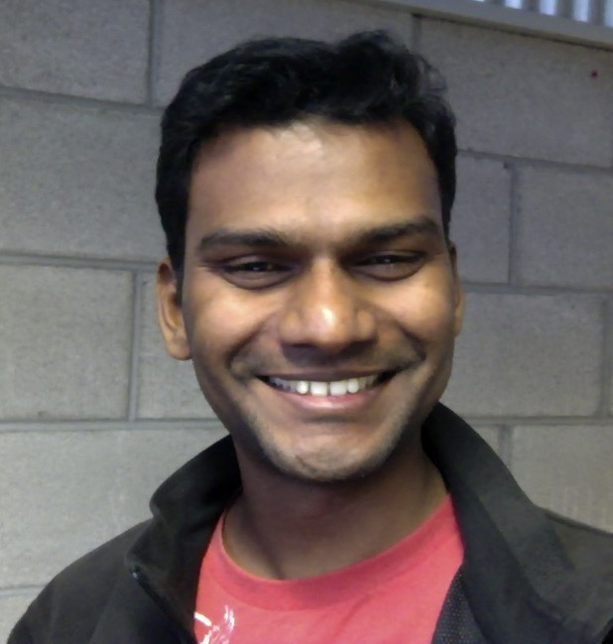

Team
Ashish Gupta
Shawn Eddy
Shun Sankara
Peter Markley

Slide 3

Current plant diagnosis solutions don’t work well or quick enough. We need advanced technology.

Slide 4
What does Market Want?

Slide 5
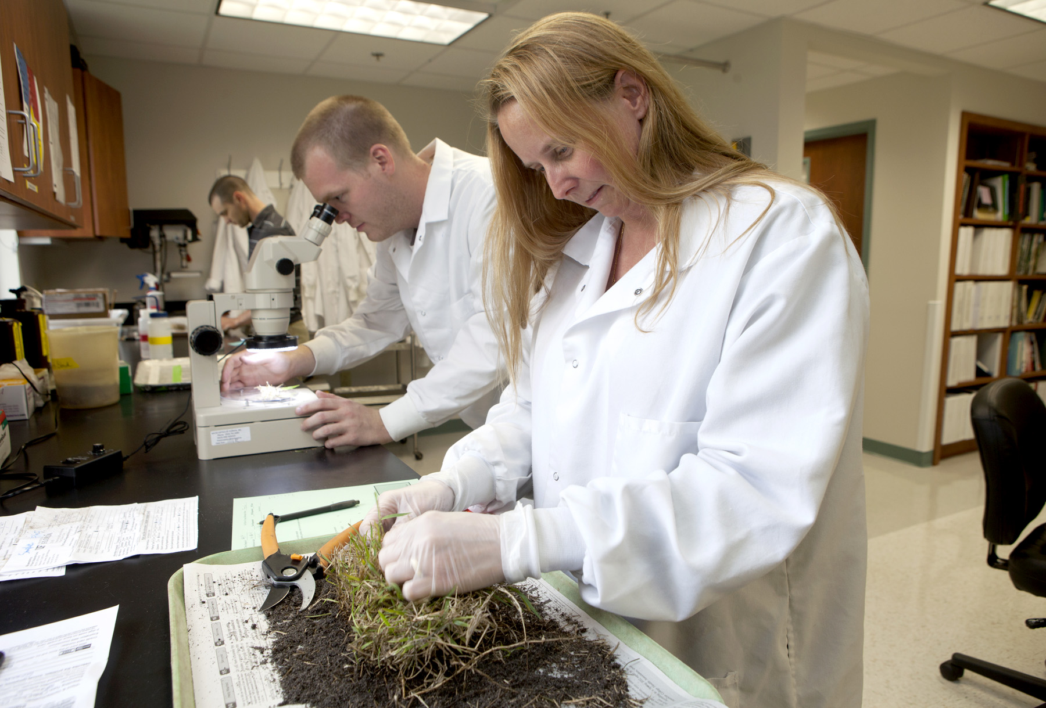
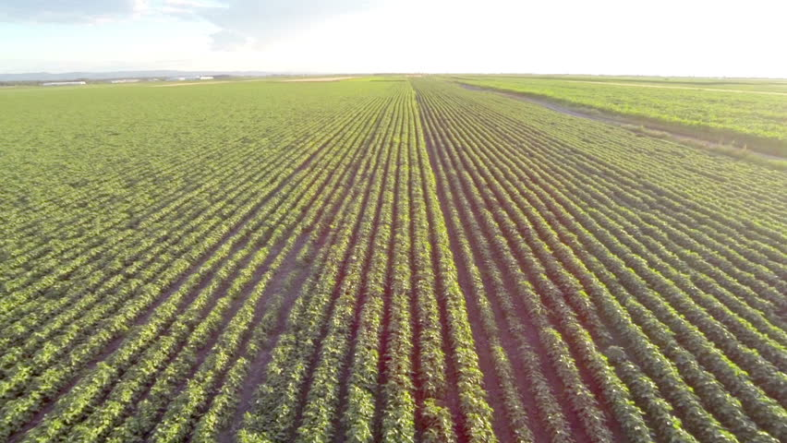
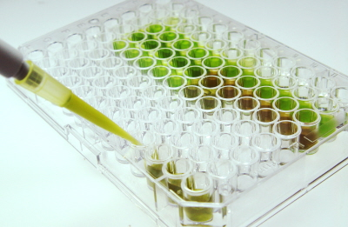
Fast!
Slow
Huge

Slide 6
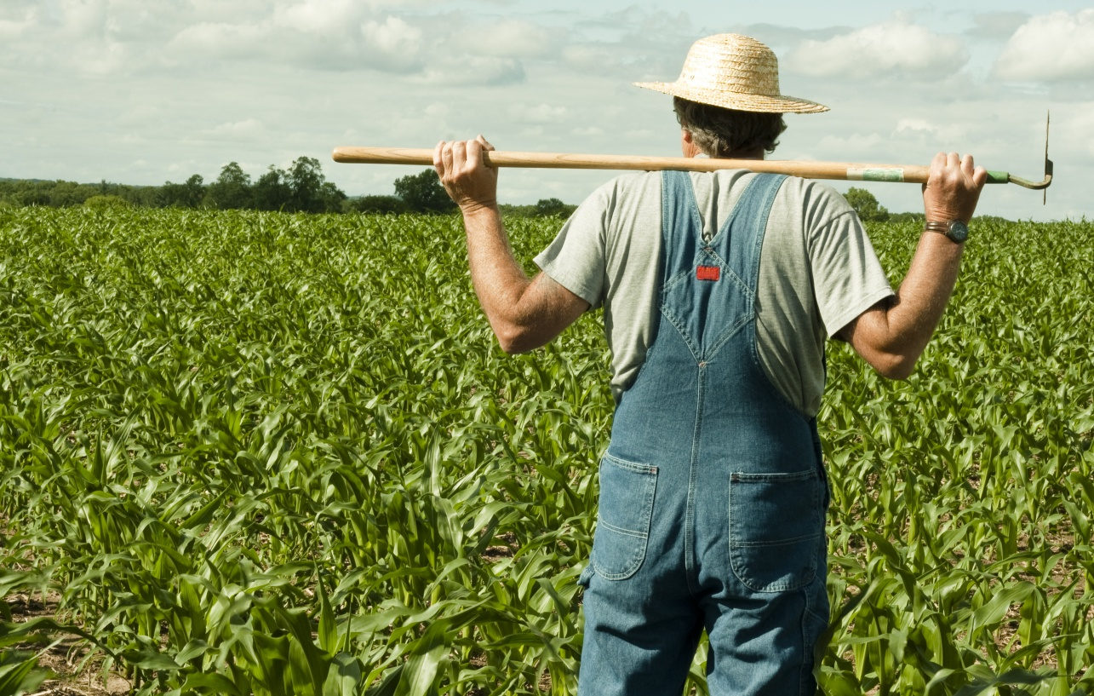
Simple

Slide 7
Our Solution

Slide 8
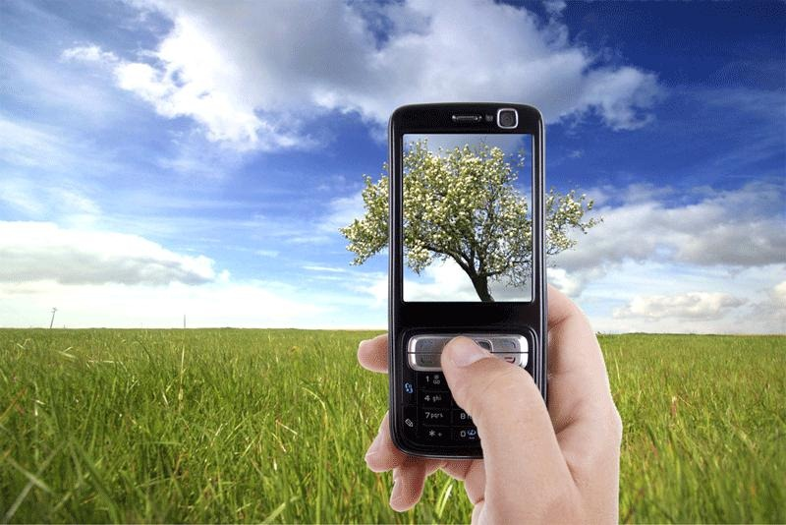
Ubiquitous Cellular Camera
Product

Slide 9
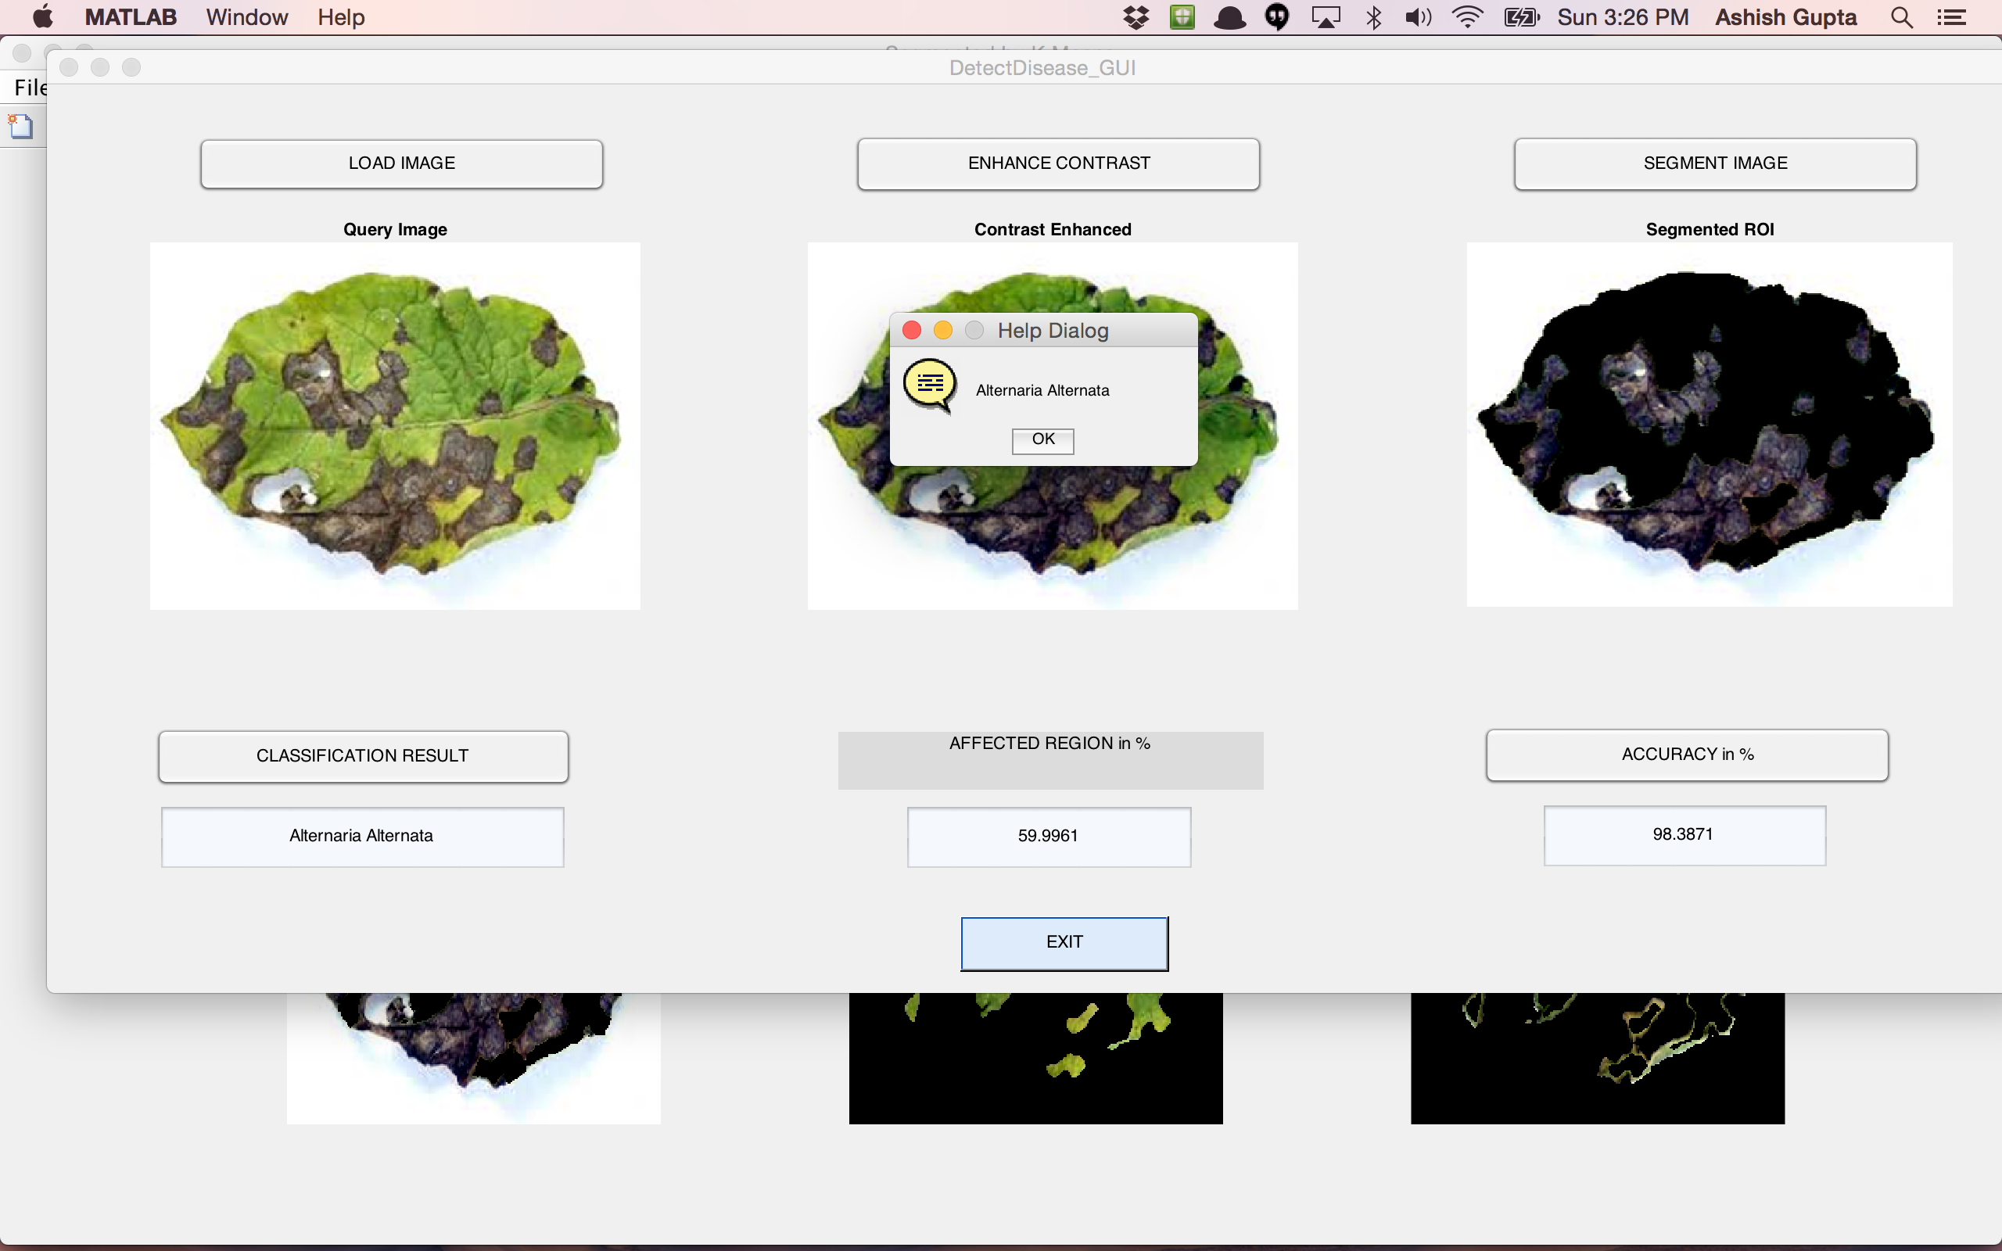
Automatic Identification
Service

Slide 10
We are an automatic plant health monitoring solutions company.
Who we are

Slide 11
What we do
Service to large and small agribusiness to automate their agricultural resource diagnosis.
We provide fingertip information to both novice and experienced farmers.

Slide 12

How we do it

Slide 13
System Architecture Overview

Slide 14
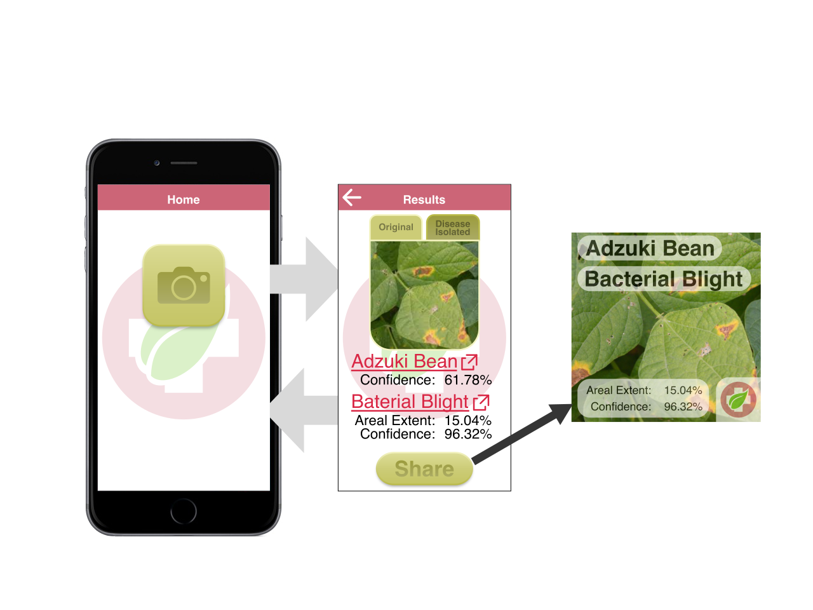
Mobile App

Slide 15
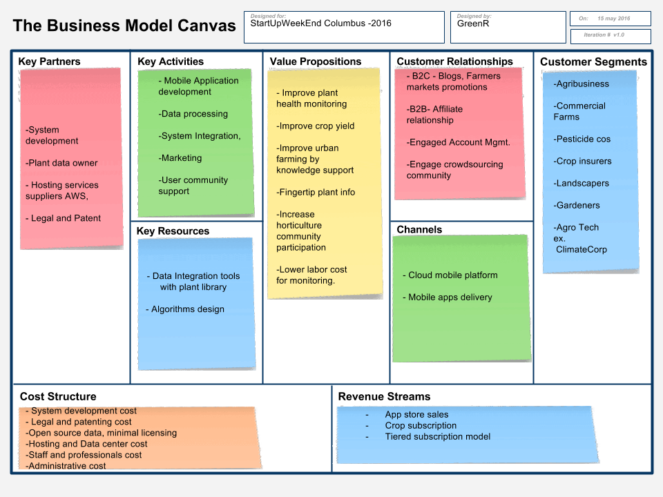

Slide 16
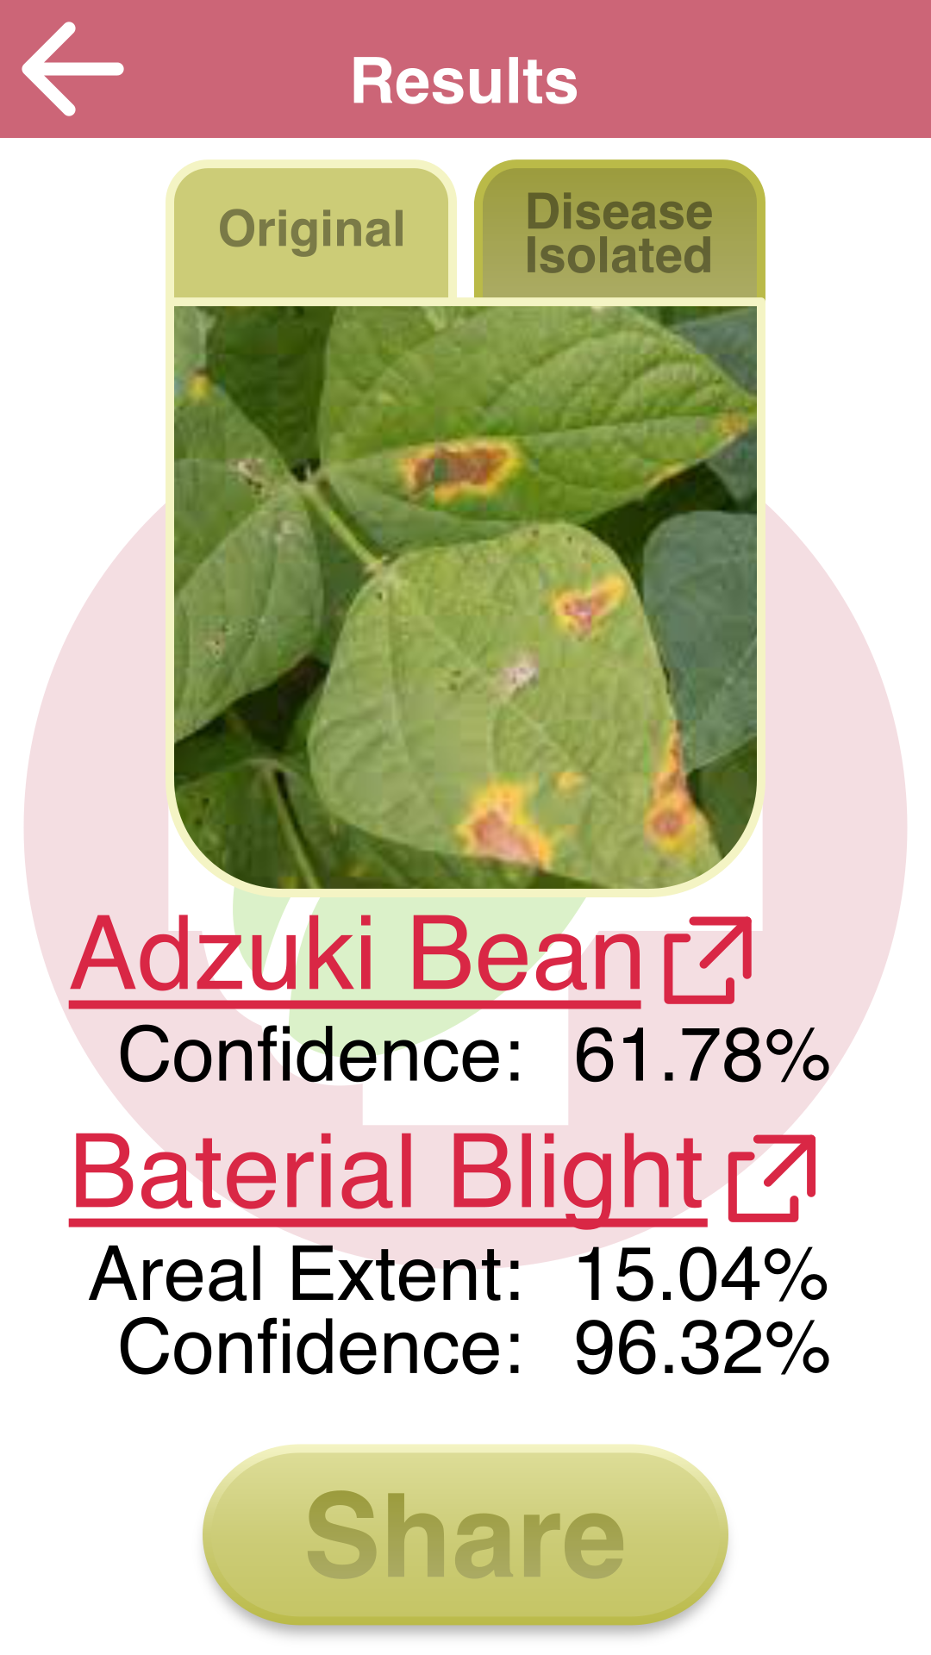

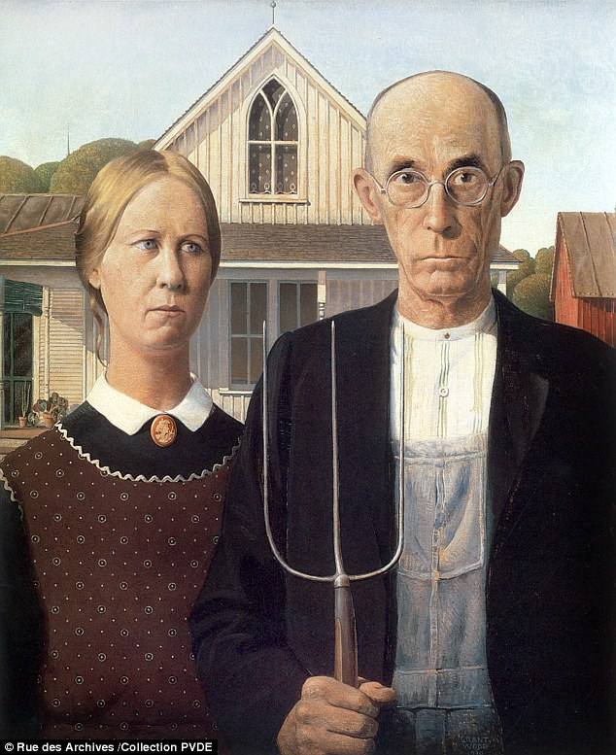
Thank You !

